Slide 1
Optimizations
Building Personal Websites
Lecture 12 | Optimizations

Slide 2
Optimizing Screen Sizes
Cross-Browser Support
Building Personal Websites
Lecture 12 | Optimizations

Slide 3
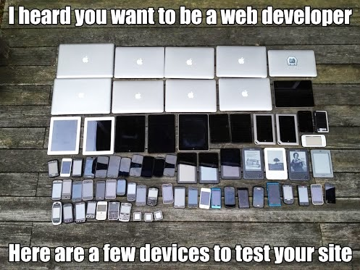
Building Personal Websites
Lecture 12 | Optimizations

Slide 4
width > 1024px
1024px > width > 480px
480px > width > 250px
Building Personal Websites
Lecture 12 | Optimizations

Slide 5
width > 780px
780px > width > 250px
Building Personal Websites
Lecture 12 | Optimizations

Slide 6
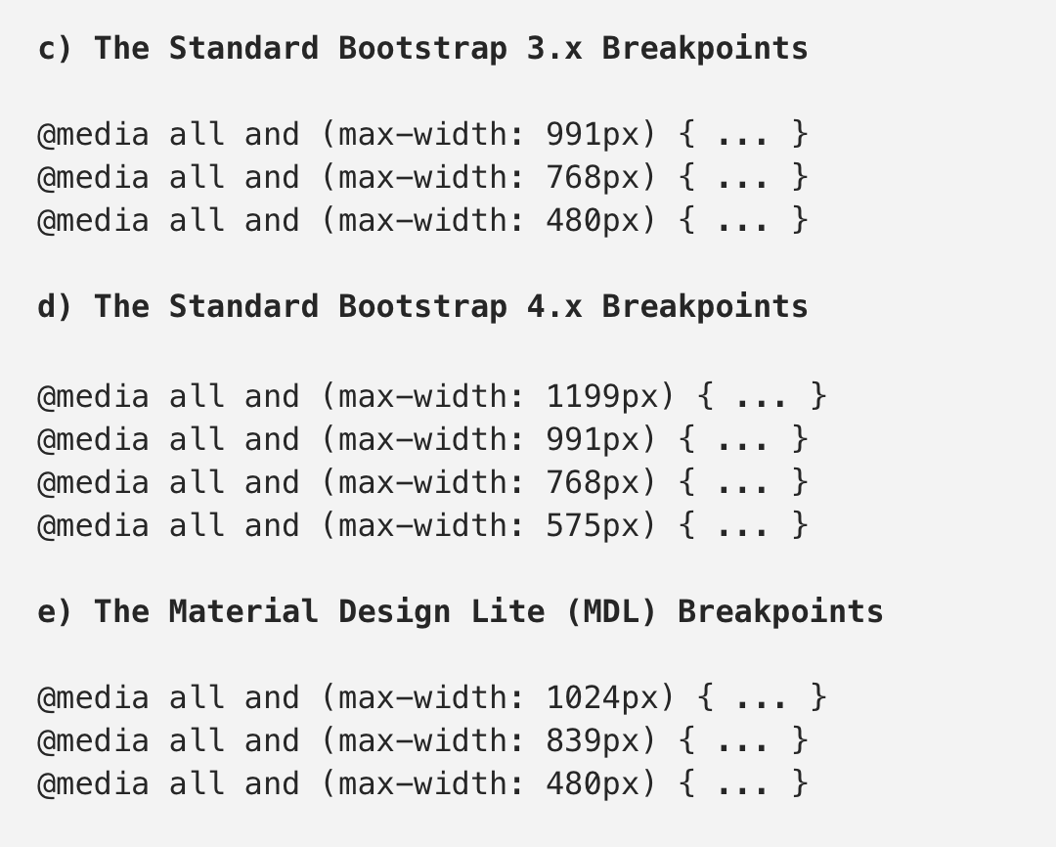
Breakpoint Examples
src: https://medium.com/@uiuxlab/the-most-used-responsive-breakpoints-in-2017-of-mine-9588e9bd3a8a
Building Personal Websites
Lecture 12 | Optimizations

Slide 7
Setting Breakpoints
Regular CSS…
@media (max-width: 1024px) {
Tablet CSS…
}
@media (max-width: 480px) {
Phone CSS…
}
Building Personal Websites
Lecture 12 | Optimizations

Slide 8
Setting Breakpoints
Regular CSS…
@media (max-width: 1024px) {
Tablet CSS…
}
@media (max-width: 480px) {
Phone CSS…
}
Only executed if width < 1024
Only executed if width < 480
Building Personal Websites
Lecture 12 | Optimizations

Slide 9
Setting Breakpoints
p { font-size: 18px; }
@media (max-width: 1024px) {
p { font-size: 14px; }
}
@media (max-width: 480px) {
p { font-size: 12px; )
}
What is the font size on a 1920x1080 display? On a 720x480 display?
Building Personal Websites
Lecture 12 | Optimizations

Slide 10
Optimizing Screen Sizes
Cross-Browser Support
Building Personal Websites
Lecture 12 | Optimizations

Slide 11
Not all browsers share the same modern-day HTML features
CSS features
JQuery features
You can set fallback behaviors such as displaying text or images in place of failed-to-load content
The default fallback is to not display at all (skip over the element)
Building Personal Websites
Lecture 12 | Optimizations

Slide 12




.move-me:hover { -ms-transform: translate(0%, 42%);
-webkit-transform: translate(0%, 42%);
-moz-transform: translate(0%, 42%);
-o-transform: translate(0%, 42%);
}
Building Personal Websites
Lecture 12 | Optimizations

Slide 13
Live Demo
Building Personal Websites
Lecture 12 | Optimizations

